Slide 1
Marvel Cinematic Universe
By: Danny Pham, Caroline Ambriz, Nicholas Hanashiro, Dinnara Hitt

Slide 2
Why Marvel?
With the Film and Entertainment industry being such a huge business in the U.S., by roughly generating over 30 billion a year in revenue we wanted to take a closer look into this industry.
The Marvel Cinematic Universe stood out to us the most. They have a plethora of movies all under their umbrella, we knew we would we able to analyze their data and draw clear conclusions into their profitability.

Slide 3
Our Inquiry
Query 1
Query 2
Query 3
Query 4
Who is the most liked and most profitable actor?
We believe that either Robert Downey Jr. or Chris Evans would be the most profitable actors to the franchise
Between Iron Man and Captain America, who made the most money?
Will compare domestically and internationally
We believe Iron Man has made more money than Captain America
Do teamup movies gross more than solo and sequel movies?
Will show domestic and global gross box office
Compare and contract how solo movies do in domestic vs global box office
What is the correlation between ratings and sales?
We believe that movies with higher ratings are generating more net profit than less rated ones.

Slide 4
Understanding the market

Slide 5
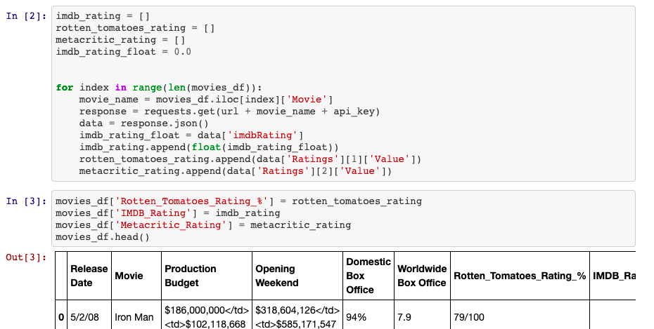
The Data (our sources)
Ite 1
Where did we pull from?
We dug through the internet and found that DataStock had created a free csv file we could download.
It contained a lot of information we needed
OMDb API
We were able to write loops and pull any missing information we needed that wasn’t already present in the csv’s.
https://github.com/dmhitt/Group1-Avengers

Slide 6
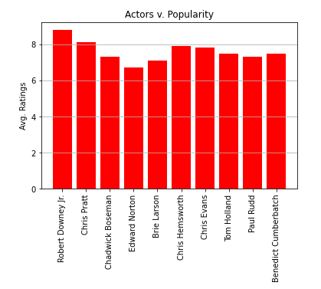
Findings
The leading actors in their respective franchises had roughly the same average ratings per movie.
As we had suspected Robert Downey Jr. was the actor with the highest average ratings, but Chris Pratt came in second and not Evans.

Slide 7
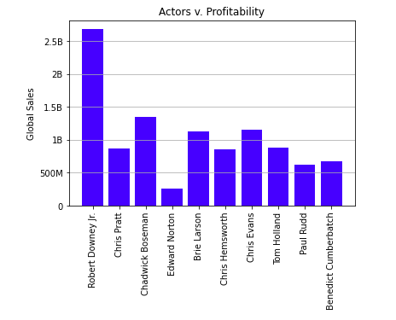
Who generates the most profit?
Ite 1
Findings
With Robert Downey Jr. having been the leading actor in most amount of movies, it was no surprise that he trumped in global sales. Making him the most profitable actor for Marvel.
Followed by the late Chadwick Boseman, and then Chris Evans.

Slide 8
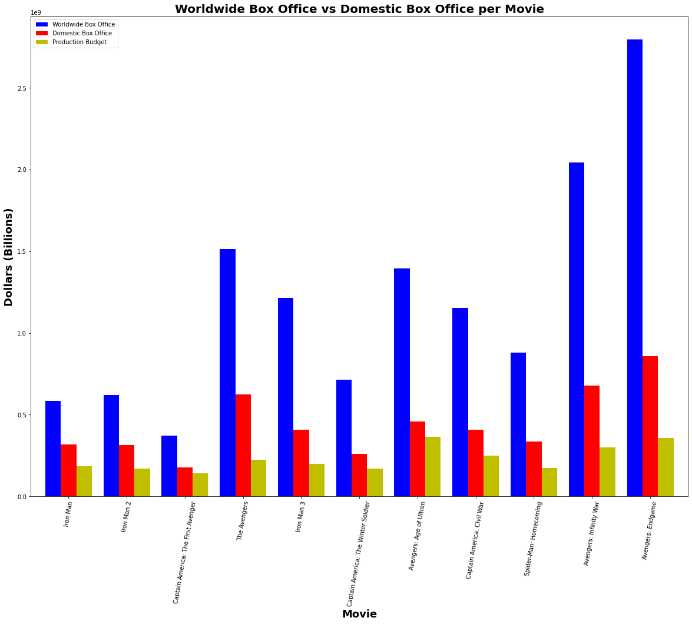
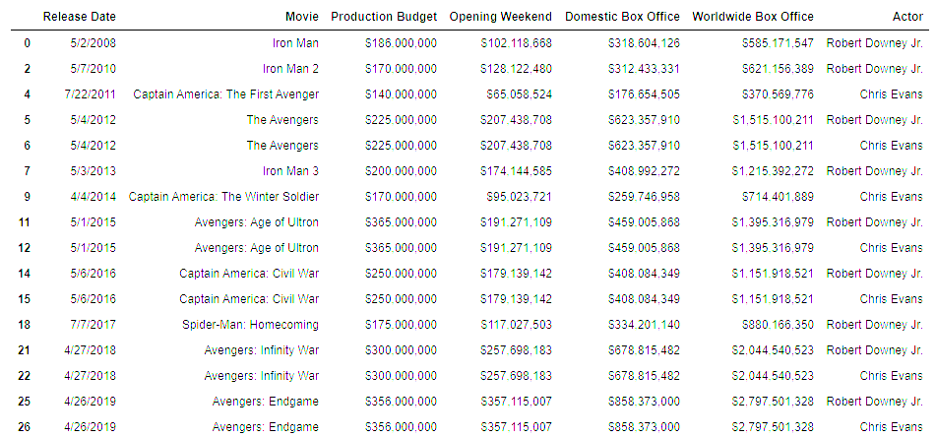
Worldwide and Domestic Box Office for Iron Man and Captain America

Slide 9
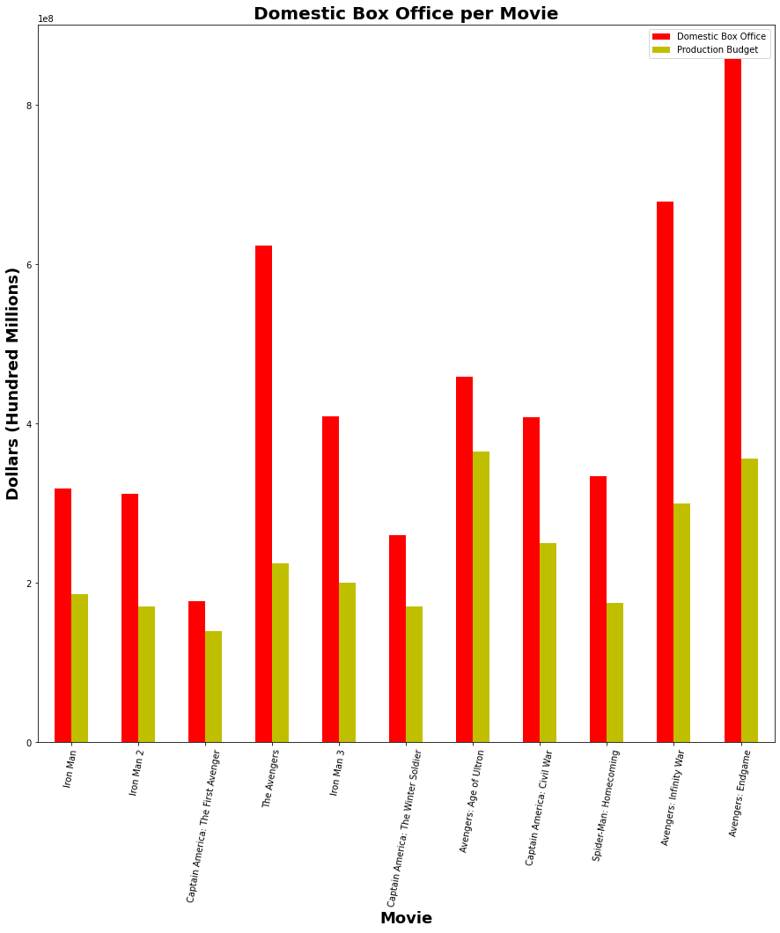
Domestic Box Office per Movie
Iron Man
Total Profit: $2,174,867,478
Average per Movie: $241,651,942
Captain America
Total Profit: $1,658,038,072
Average per movie: $236,862,582
Winner: Iron Man

Slide 10
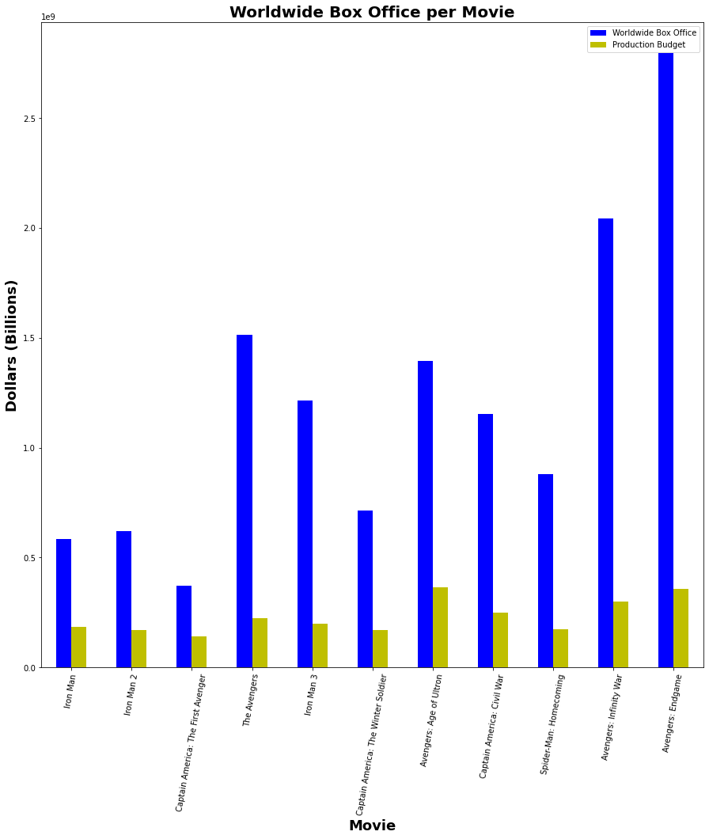
Worldwide Box Office per Movie
Iron Man
Total Profit: $9,979,264,120
Average per Movie: $1,108,807,124
Captain America
Total Profit: $8,183,349,227
Average per movie: $1,169,049,890
Winner: Captain America

Slide 11
Conclusion
Between the two characters, Captain America and Iron Man, they showed up in 16 movies total. Iron Man appeared in 9 movies while Cap appeared up in 7.
Granted that Iron Man shows up in more movies, we expect him to have greater total profit than Captain America. This holds true for both domestically and worldwide.
Iron Man beats out Captain America in profit per movie domestically.
Interestingly enough, Captain America actually beats Iron Man in profit per movie worldwide.
All in all, both characters generated over billions of dollars total. Iron Man seems to be more profitable domestically but Captain America appears to be more profitable worldwide.

Slide 12
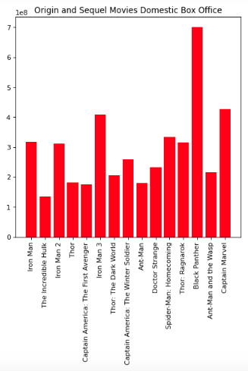
Solo/Sequel Findings:
Domestic
Ite 1
Findings
We defined solo and sequel movies as anything that was not a teamup movie and endud up with 15 movies. We kept our scope to end with Avengers Endgame, and therefore Spiderman Far From Home is not on this list
Average Domestic Box Office:
$293,618,168

Slide 13
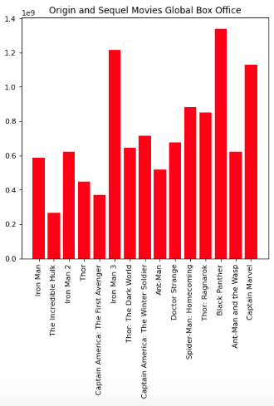
Solo/Sequel Findings:
Global
Ite 1
Findings
Very different to the team-up movies, some solo Marvel movies perform up to 3 times as well, like Iron Man 3 or Captain Marvel, but will normally do around 2 times as well.
Average Global Box Office:
$725,428,219

Slide 14
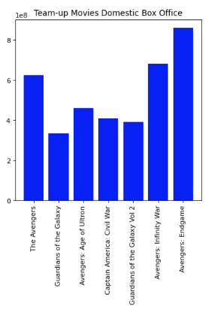
Team Up Findings - Domestic
Y-axis - in $100,000,000
We decided to use 7 movies pre-defined by a previous article as “team-ups” which defined team-up movies as marvel movies with 5 or greater heroes as the main force.
Average Domestic Box:
$535,880,546

Slide 15
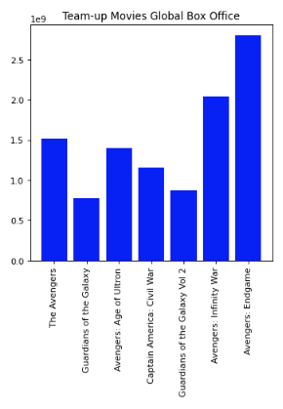
Team Up Findings - Global
Y-axis - in $1,000,000,000
Consistency is the name of the game, in a very close ratio the global box office is almost always about 3 times as large as its domestic box office
Average Global Box:
$ 1,506,339,008

Slide 16
Are Teamup Movies More Profitable?
YES!
Based on the information we were able to pull out of OMDB yes Team-up movies are almost twice as profitable than their solo and sequel counterparts, with the exception of Black Panther which outperformed all but Avengers: Endgame.
This was consistent with global box office as well, with the best performing Team-up movie being Avengers: Endgame, and best non-teamup, being Black Panther.
Global box office numbers are roughly 3 times as large as the US, even though The US population is not ⅓ of the global population, which says something about our consumer tendencies
In other words based on our findings in order to maximize global and domestic box office profits Disney should continue to make larger and larger Marvel movies.

Slide 17
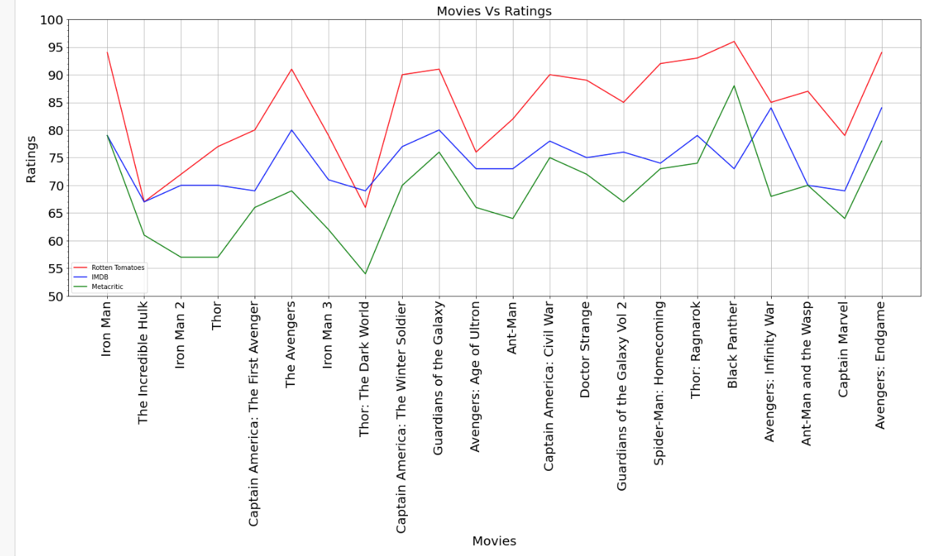
What is the correlation between ratings and sales?
Comparing the movies rating with the three most popular rating sites
Findings
Rotten Tomatoes
Highest Rating: Black Panther
Lowest Rating: Thor: The Dark World
IMDB
Highest Rating:Avengers: Infinity War and Avengers: Endgame
Lowest Rating: The Incredible Hulk
Metacritic
Highest rating: Black Panther
Lowest Rating: Thor: The Dark World

Slide 18
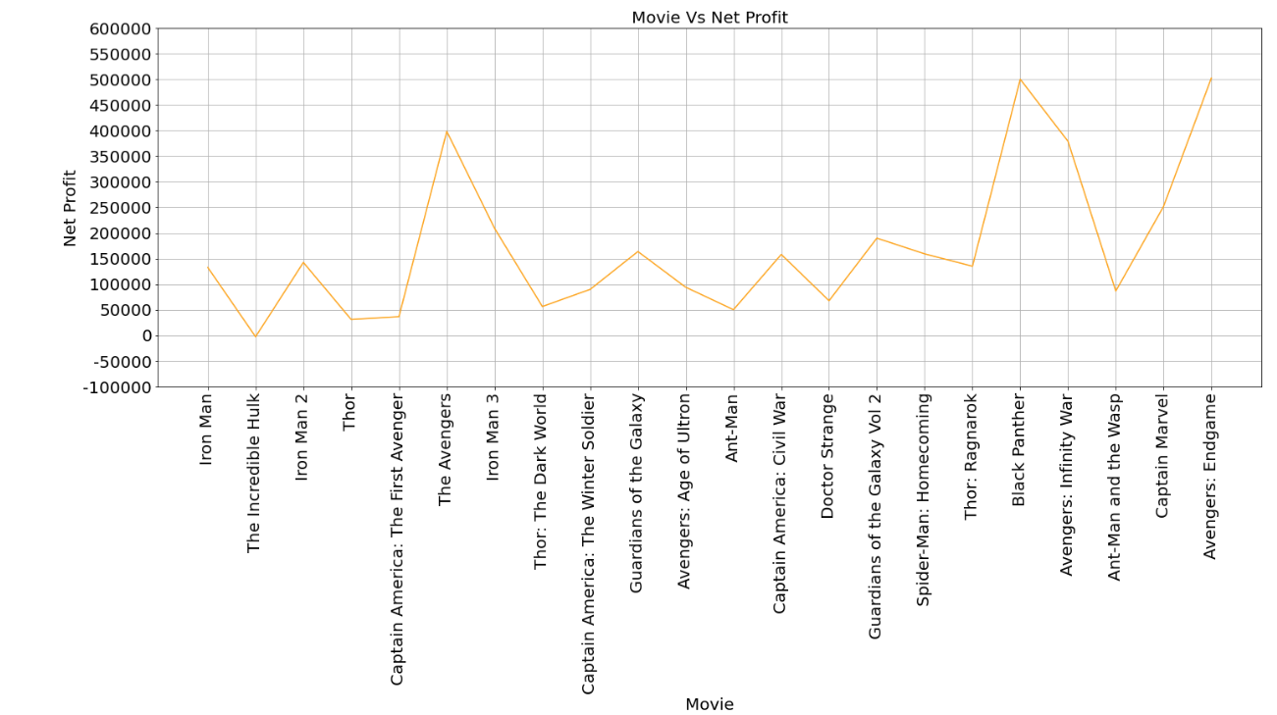
What is the correlation between ratings and sales?
The net profit by movie
Findings
Most profitable
Avengers End Game
Black Panther
Least Profitable
The Incredible Hulk
Thor

Slide 19
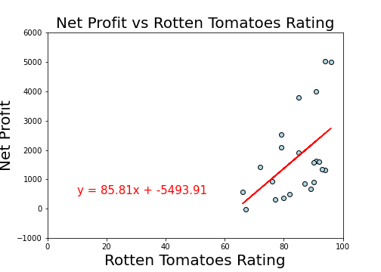
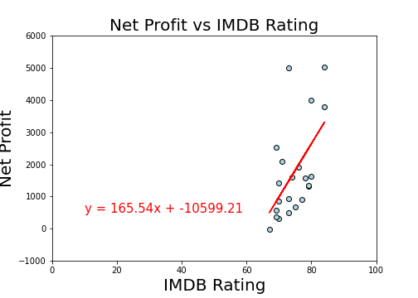
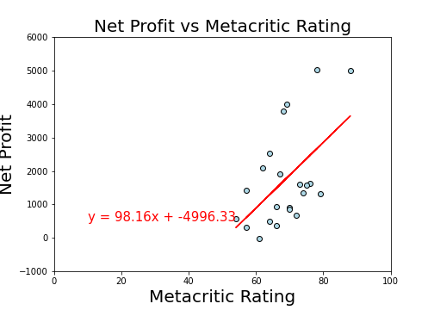
Are movies with higher ratings generating more net profit than less rated ones?
Comparing the Net Profit with each Rating Site for all movies
Conclusion:
The line regression graph for all three ratings sites shows that the correlation between most profitable and rating is moderate with r-value around 0.5
The r-value is: 0.52
The r-value is: 0.57
The r-value is: 0.54

Slide 20
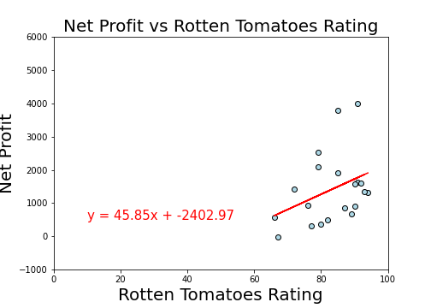
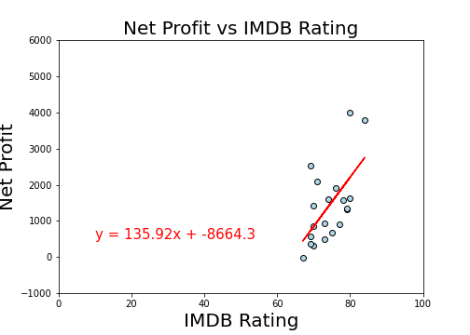
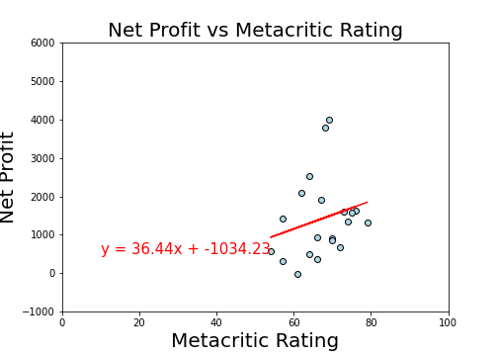
Are movies with higher ratings generating more net profit than less rated ones?
Comparing the Net Profit, without the outliers movies, for each rating site.
Conclusion without the outliers:
The regression line graph for Rotten Tomatoes shows that the correlation is weak with r-value of 0.37
The regression line graph for Metacritic also shows that the correlation is very weak with r-value of 0.23
The regression line graph for IMDB shows that the correlation is strong with r-value of 0.61
The r-value is: 0.37
The r-value is: 0.61
The r-value is: 0.23
The outliers movies were the two with highest net profit: Black Panther and Avengers End Game

Slide 21
In Summary
Based off of the information we were able to pull we can see that Robert Downey Jr. is the most profitable actor for the Marvel Universe.
He held the highest individual rating and generated the most amount of profit on average over $2.5 billion per movie in which he is the leading actor
The two actors who showed up in the most amount of movies were Robert Downey Jr. (Iron Man) and Chris Evans (Captain America)
Iron Man, having appeared in the most movies, generates the most profit domestically per movie
Captain America generates the most in worldwide sales per movie
Team or grouped movies, like the Avengers, are twice as profitable compared to solo movies
The exception being Black Panther which outperformed all but Avengers: End Game
It's in Disney's better interest to continue to make larger scale movies
Based off of the reviews from the three different movie critic scores Black Panther was the highest rated movie and Thor: The Dark World being the lowest rated
We found there was a positive correlation between ratings and box office sales. The higher rated the movie the more profit it generates

Slide 22
Problem Solving

Slide 23
Problems that arose and solutions
Caroline
Problem graphing using the collective box office data
Write a loop to turn data into a string to remove the “$” and “,” then convert the number back into a float to be able to graph
Nicholas
Graphing things like movies makes long names difficult to graph, until we used rotation to be able to rotate the names of movies 90 degrees
Sorting by date
Name your figures something besides fig1, and fig2
Danny
Changing data from strings to numericals so they can be graphed then reformat back to placed into a dataframe
Found a way to remove “$” then graphed the data. Reformat the numbers so it has the “$” again
Dinnara
Changing the domestic box office data from string to numeric to be able to graph.
Finding the best graph to show all 3 rating sites. First, I did with a bar chart, but it was very crowded and we could not see the trend between the 3 rating sites.
Getting the max and min values of a column without grouping the data and get the corresponding movie from another column using the index.

Slide 24
Scope improvements
Box office by country
Geographic box office was a difficult data set to find, some countries and some states would be available but there wasn’t an easily accessible data set for this
Based on how sequels usually do compared to their originals we could have forecasted how proposed future sequels would perform
Included TV shows like WandaVision
We could have worked on code to try and scrape certain websites for more information on the movies
All in all we are still constrained to having only 20-ish movies to go off of, so our data let would never get that long, but it would just get wider

Slide 25
Questions?
What’s your favorite marvel movie/character?

